Slide 1
Using Machine Learning to Predict Real Estate Costs
By
Arushi Agarwal
Hari Krishna Edvalapati
Soumya Kasireddy
Jessica Reynolds
Notes:
Hari

Slide 2
The Problem
Understanding the value of a house in the current market is important for realtors, potential homebuyers/sellers, and lenders. In our project, we aim to investigate which features of a house have the highest correlation with housing prices in order to generate a model to accurately predict the cost of residential homes in the United States.
Notes:
Hari

Slide 3
Data Set Information
The dataset has been collected from the source https://www.kaggle.com/datasets/promptcloud/real-estate-data-from-trulia
Size of the dataset -23MB
Rows-30019
Columns-68
Notes:
Soumya

Slide 4
Exploratory Data Analysis
There are total 68 columns in the dataset.There is a column named Features which has lot of information.
We also determined House Age as new column by using Year Built column.
We also removed duplicate rows and checked null values using heat map.(visualization)
Notes:
Soumya

Slide 5
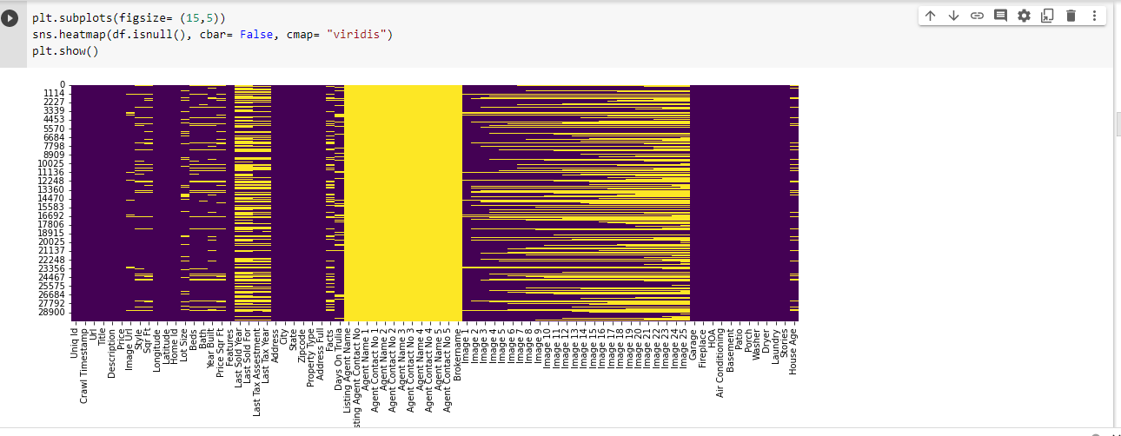
Exploratory Data Analysis
Notes:
Soumya

Slide 6
Exploratory Data Analysis
Filled missing values in specific columns such as Lot Size, Beds, Bath, Year Built, House Age.
We have also created a price category column where the price conditions are given and bands are created according to conditions.
Notes:
Soumya

Slide 7
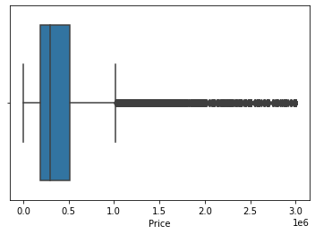
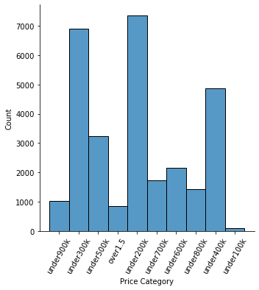
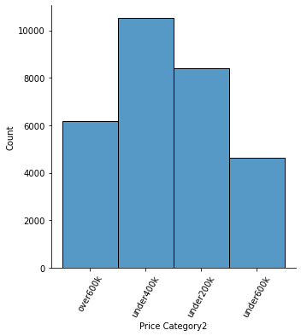
Target Variable:
‘Price’
‘Price Category’ ‘Price Category2’
Notes:
Soumya

Slide 8
Categorical
Features:
State: 50 categories
Property Type: 9 categories
Garage: Binary
Fireplace: Binary
HOA: Binary
Air Conditioning: Binary
Basement: Binary
Porch/Patio: Binary
Washer: Binary
Dryer: Binary
Laundry: Binary
Zip code: 2509 categories
Notes:
Soumya

Slide 9
Continuous
Features:
Sqr Ft: sum of the area of each room
Mean: 4779 sq ft
Median: 1718 sq ft
Lot Size: area of the land
Mean: 79946 sq ft
Median: 6416 sq ft
House Age: Number of years since house was built, -1 for empty lot
**Beds: number of bedrooms
Integer values
**Bath: number of bathrooms
Whole, half, and quarters
**Stories: Number of floors
Integer values
**While technically categorical, can be treated as either categorical or continuous since the feature is ordinal.
Notes:
Soumya

Slide 10
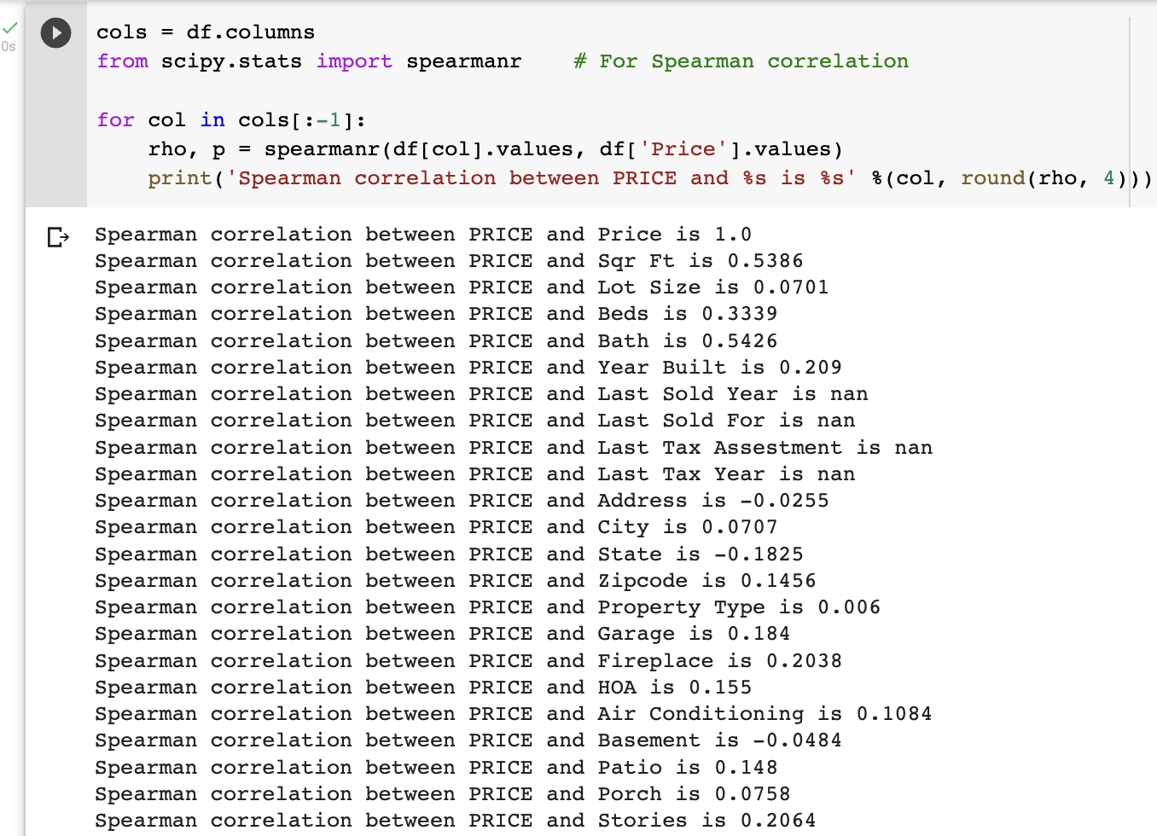
Finding Imp Features Using Pearson & Spearman Correlation
Using Spearman Correlation we find the important features that are related to our target variable.It is observed that Bath,Bed,Sq Ft and state has highest relation with respect to the Price Variable.

Slide 11
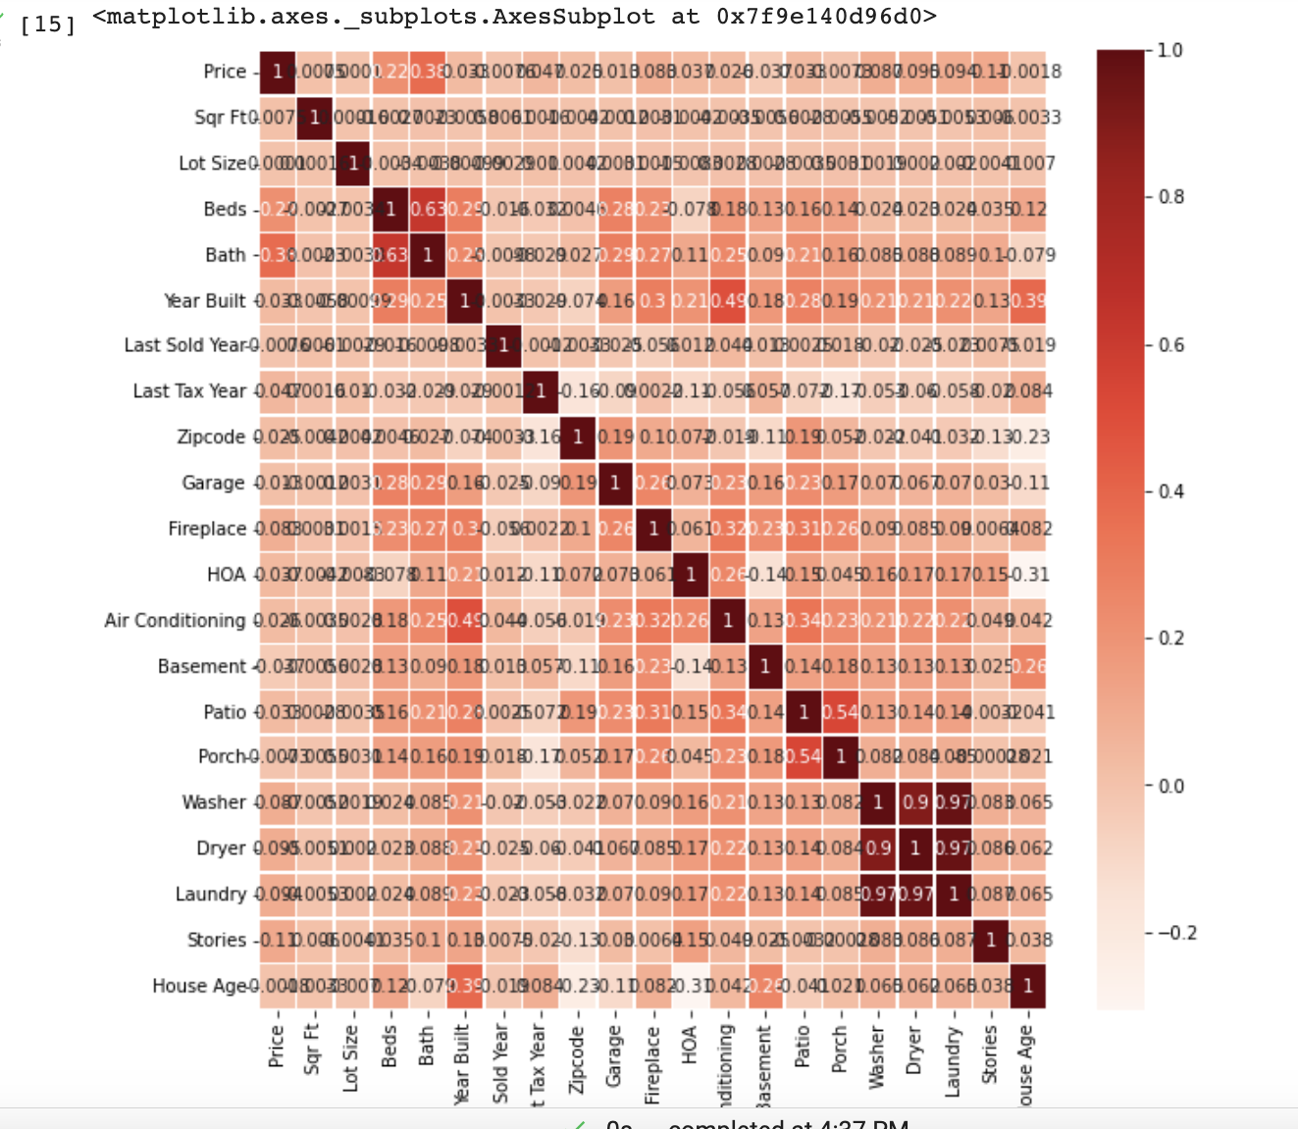
Pearson Correlation

Slide 12
Regression models:
Linear Regression Model:-
Test :- Train:-
16% 19%
Lasso Regression:-
Test:- Train:-
14% 17%
After Using Specific State Columns:-(State_tx,State_ca,State_fl)
Test:- Train:-
19% 19%
Notes:
Hari

Slide 13
Methods Used to increase Accuracy
Since our Target Variable mostly depend on one of the non-numeric column i;e “State” Column .
Since location of the house are dependent variable which affects the price of the house
Increased Performance After Specific location
Able to increase about 5% more than the prev results

Slide 14
Boosting Model
XGBoost:-(Total Dataset)
Train:- Test:-
81% 20%
XGBoost(Specific States) :-
Features:- Sq ft ,Bed, Bath , House Age, State_TX,State_CA,State_Fl
Train:- Test:-
94% 33%
Since test data is less Accurate,data is trying to overfit the model.
After Hypertuning:-
Same Results

Slide 15
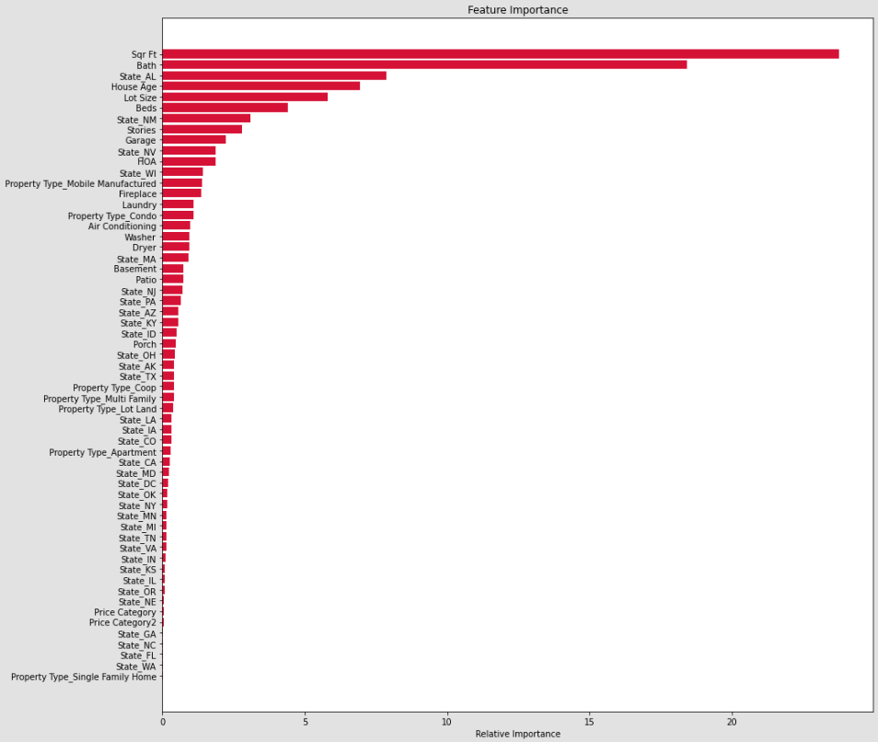
Classifiers
Feature Importance Using Random Forest Classifier
Important Features Used-
Sqr Ft
Bath
House Age
Lot Size
Beds
Notes:
Arushi

Slide 16
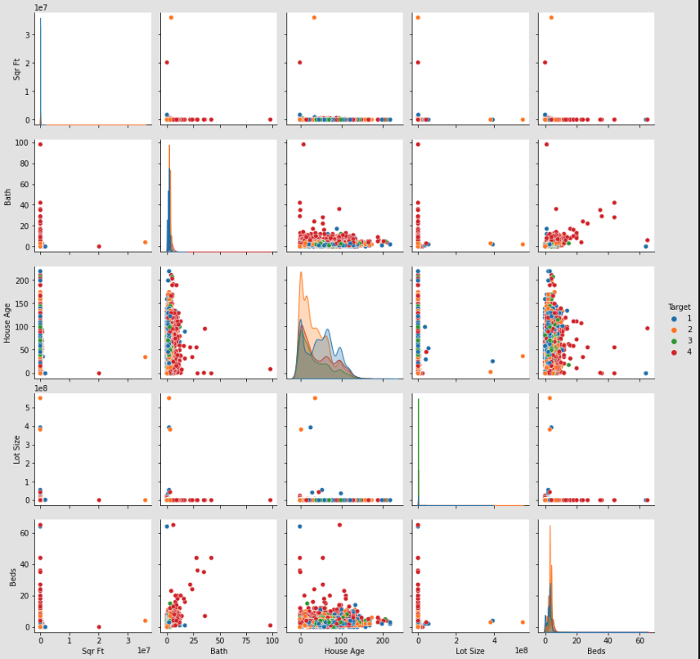
Pairplots

Slide 17
Accuracy Percentage with Different Classifiers
Logistic Regression
Train- 23% Test- 23%
Linear Discriminant Analysis (LDA)
Train- 58% Test- 58%
Decision Trees (max_leaf_nodes=99, min_samples_split= 2)
Train- 67% Test- 61%
Random Forest Classifier (n_estimators=100, max_depth=13, max_leaf_nodes=49)
Train- 62% Test- 62%
Gradient Boosting Classifier
Train- 66% Test- 65%
Notes:
Arushi

Slide 18
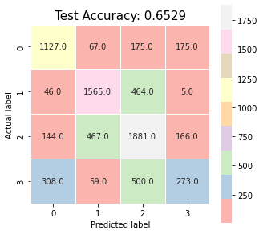
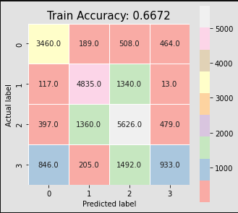
Stacking
Classifiers Used-
Decision Trees
Random Forest Classifier
Gradient Boosting Classifier
Train - 67% Test - 65%
Notes:
Arushi

Slide 19
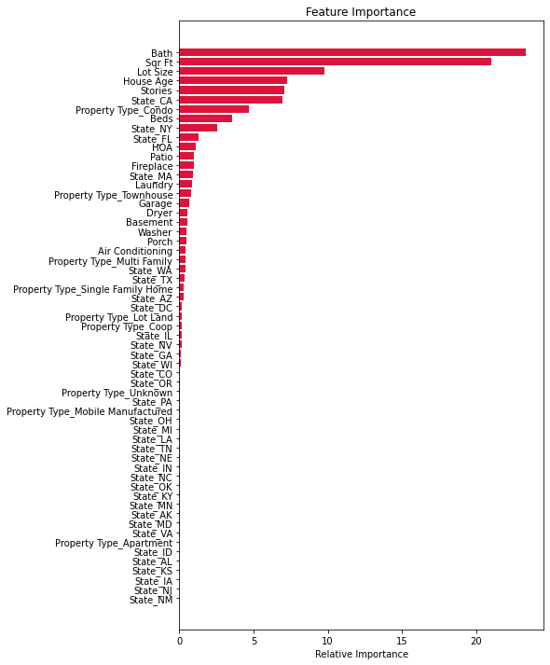
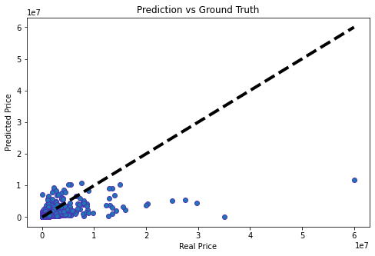
Random Forest Regression
Selected Important Features:
Stories, Bath, Beds, Sqr Ft, Lot Size, House Age
Hyperparameters
n_estimators=1000, max_depth=15, max_features=’sqrt’, min_samples_split = 2
Without Bagging: With Bagging:
Train R^2: 0.83 Train R^2: 0.6619
Test R^2: 0.327 Test R^2: 0.2488
Notes:
Classification only has 4 bands which

Slide 20
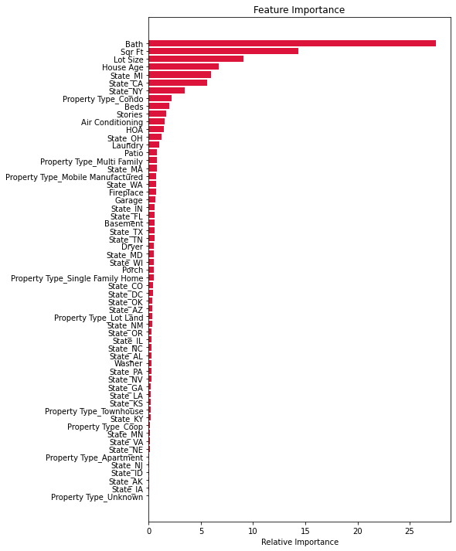
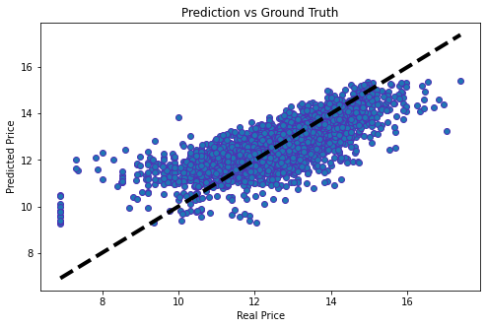
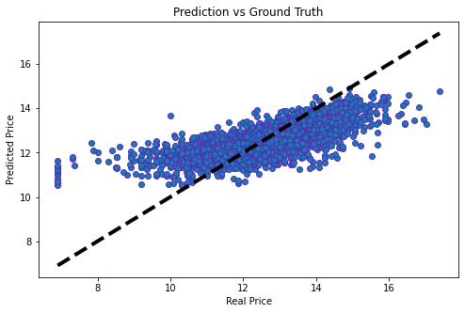
Scaling and Removing Outliers
Selected Important Features:
Stories, Bath, Beds, Sqr Ft, Lot Size, House Age
State_CA, State_MI, State_TX
Hyperparameters:
n_estimators=1000, max_depth=15, max_features=’log2’, min_samples_split = 50
Without Bagging: With Bagging
Train R^2: 0.646 Train R^2: 0. 613
Test R^2: 0.586 Test R^2: 0.485
Notes:
Looking at a single tree with the same hyper parameters, there are 1,114 leaves so even though it is still using the mean of a group, the groups each tree is subsetting is much smaller than the categories we made.

Slide 21
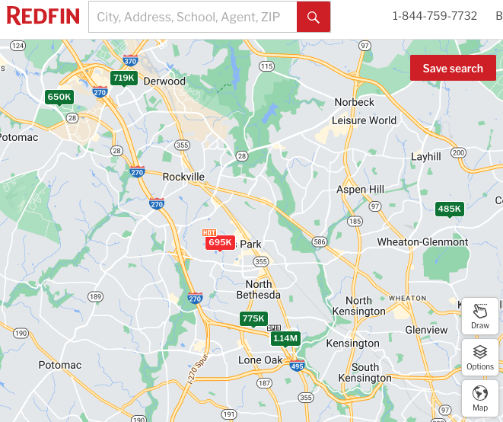
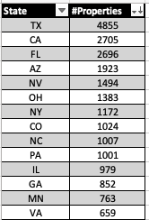
Limitations and Next steps:
Location, Location, Location!
These properties are condos with similar features but, as we can see, they have vastly different prices.
Notes:
Limitation: Looking at a map of current properties with the same property type and features have drastically different prices even though all of these properties are within a 6 mile radius of one another.
Our data set is distributed through 34 states and DC with only 10 states having over 1000 properties. If you break this down further by Zipcode to get even more specific, there are 2509 zipcodes within the dataset with the highest count of properties being 110.

Slide 22
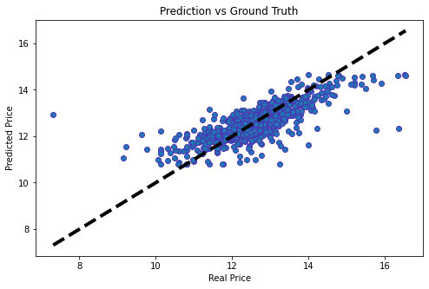
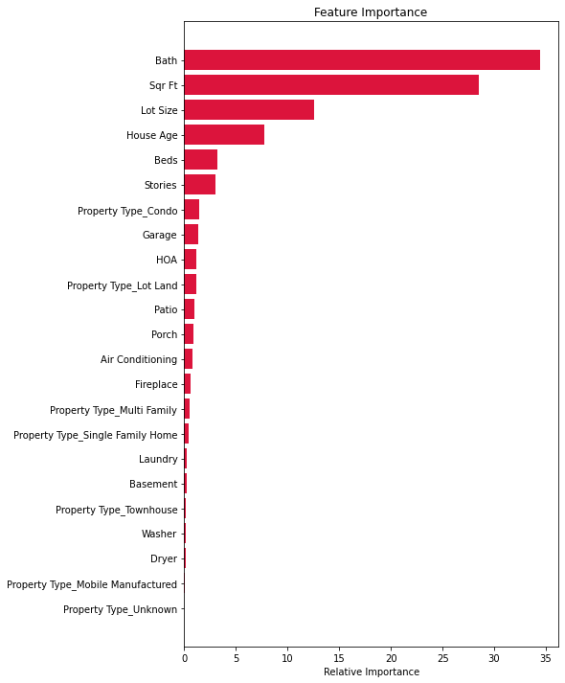
Looking at only Properties in Texas
R^2 score for train dataset = 0.6833
R^2 score for test dataset = 0.5991
Notes:
Jessica

Slide 23



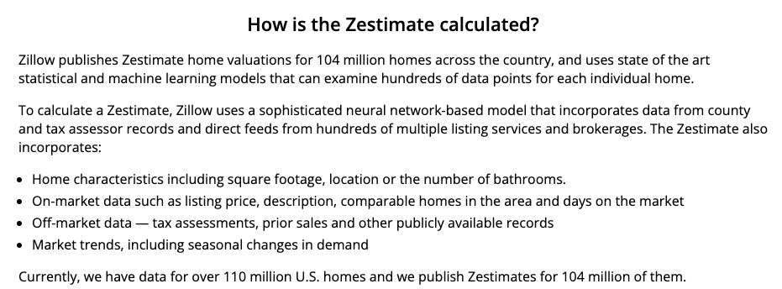
Comparison to Existing model performance:
Companies like Zillow, Redfin and Realtor.com are all working towards developing better and better algorithms that accurately price homes.
The Median Absolute Error for the best performing Random Forest Regressor
ALL 50 States: 32.8% Texas: 23.4%
Source: https://www.zillow.com/z/zestimate/
Notes:
Zillow claims to have a data set over 110 million homes in the US, working with only 0.027% of the data

Slide 24
Other Research:
How to distinguish if a location is ‘desirable’ from publicly available information?
Using publicly available data on traffic
https://doi.org/10.1016/j.engappai.2021.104513
Taxi cab rides in NYC
https://doi.org/10.1016/j.physa.2022.128306
NLP of Property descriptions
https://doi.org/10.1016/j.eswa.2022.119147
Distance to points of interest
https://doi.org/10.1016/j.cities.2022.103941
Google Maps
https://doi.org/10.1016/j.habitatint.2021.102463
Notes:
Used decision trees for their ability to run relatively quickly and use on specific subsets of the data, r2 0.78
temporal behavior multiplex network to understand taxi data, fed all data into a random forest regressor, 44 million rides reduced to 12 features
Did several models and found that the added features from NLP lead to a marked reduction in Mean Absolute Percent Error
Found Ensemble Tree based models performed the best with the addition of spatial data
XGboost and random forest along with POI data from google, 73%, only looked at condos

